Slide 1

Java Project on Futsal Management System
Presented by:
Rohit Prasain
Ravi Gurung
Ujan Manandhar

Slide 2
Acknowledgement
We would like to thank NCCS College for giving us this opportunity to work on the java project. We would like to express our gratitude to our teachers and friends for the support.

Slide 3
Table of Contents
Introduction
Problem Statements
Objective
Scope
Benefits
Requirement Identification
Study of existing system
Tools Used
System Design and Proposed system
Expected outcome

Slide 4
Introduction
A Futsal Management System is a software that helps to book the ground for the customer by the help of administrator of the system.
Futsal management system help the futsal owners to arrange the booking of the customer according to their required time and date.
Futsal management system rely on the database of the system for the storing the details of the customers and their booking time.
Features:
1. Keep record of details of customer like: Name, contact and the booking time and date.
2.Easy to view the booking time of the customer.

Slide 5
Problem Statement
One of major problems related to the futsal is about their booking service. Most of them have traditional file based system.
The chance of losing or misplacing the booking is high.
Two customer may book the ground for same time and date. This scenario occurs because the manual system does not have a proper management to handle it.

Slide 6
Objectives
To develop an application program for the proper management of bookings in futsal.
To avoid the duplication of booking.
To use the database to record the data.

Slide 7
Scopes
Customer – customers to book futsal by informing futsal administration.
Staffs – Edit or update the details of the customer’s bookings.
Database–To store all the booking details securely.

Slide 8
Benefits
It provides data durability by storing the data of the customer in a database
It reduces data conflict by avoiding the duplication of booking date and time.

Slide 9
Tools Used
Tools | Program
Java programing language | NetBeans
Database | MySQL
Server | Xampp

Slide 10
Requirement Identification
Software configuration:
This software package is developed using java. Microsoft xampp server is to store the database.
Operating system: Windows 7, 8, 10
Language: NetBeans 8.1
Database: Xampp server MySQL
Hardware configuration:
Processor: Pentium(R) Dual-core CPU to core i7
Hard Disk: minimum 40GB
RAM:256 MB or more

Slide 11
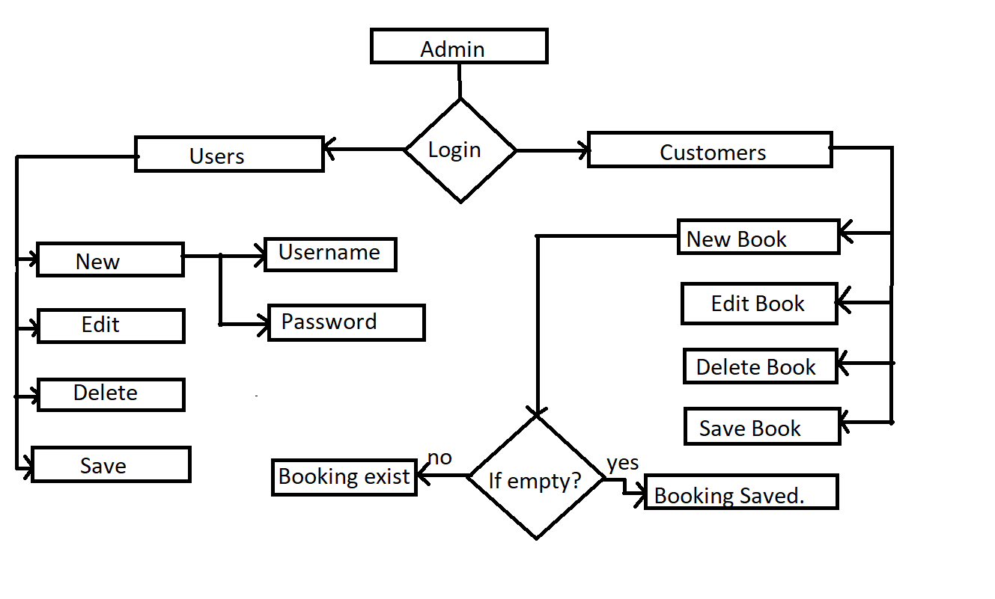
System Design of proposed System

Slide 12
Expected Outcomes
The system will be able to improve the work flow of the futsal management for the booking of the customers.
This software will help futsal owners to record the bookings without redundancy.

Slide 13
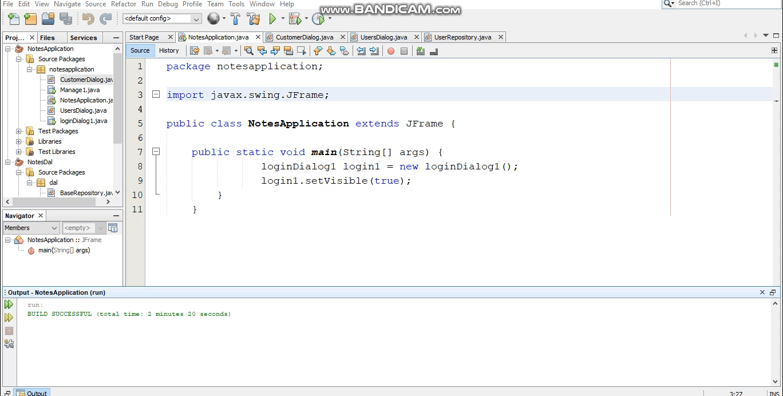
Demo

Slide 14
References
https://www.youtube.com/watch?v=9B5ZgItFxNA
https://examples.javacodegeeks.com/desktop-java/swing/jlabel/set-background-color-in-jlabel/
https://blog.eduonix.com/java-programming-2/learn-create-login-page-class-form-java-using-netbeans/
https://www.javatpoint.com/java-jbutton

Slide 15
Thank You !!!

Slide 16
ANY QUERIES??

